Slide 1
POVs & Experience Prototyping
Presenter: Lindsey Kostas

Slide 2
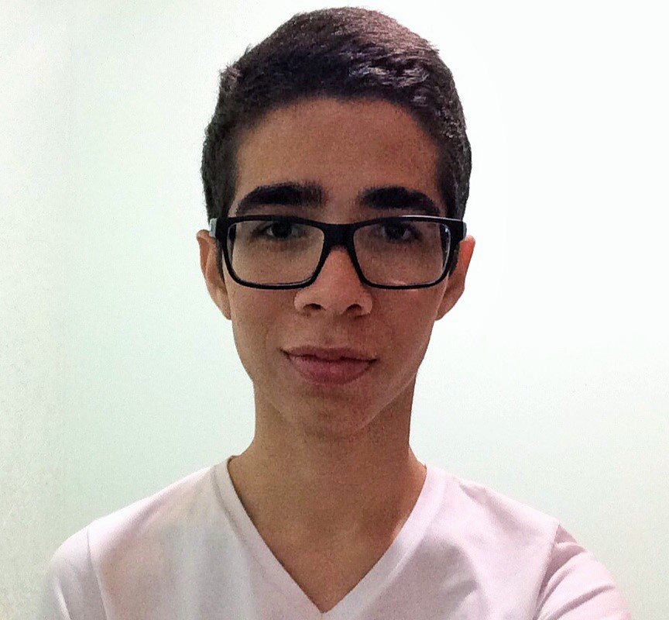
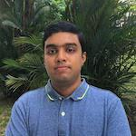

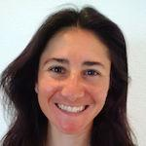
Same Team
Clay J.
Jesse C.
Lindsey K.
Senthilnathan V.

Slide 3
New Domain
FOOD
RESTRICTED EATERS
People with diets limited by food allergies, sensitivities, and other medical, religious, or moral reasons

Slide 4
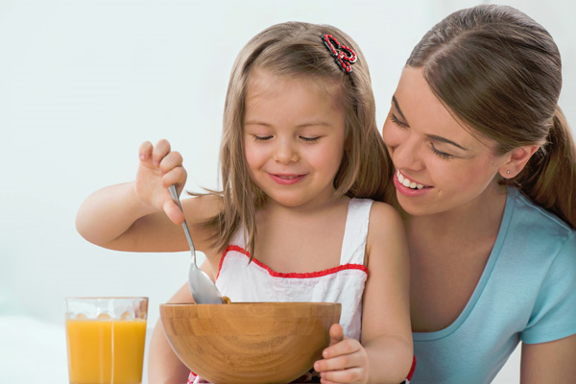
we met JESSICA, a mother of a restricted eater

Slide 5
We were AMAZED to learn it would be GAME CHANGING if
That the diet restrictions of a someone she loves could cause a person to experience so much fear and turn getting a meal into a stressful and emotionally taxing endeavor
Eating didn’t have to be the most stressful part of a person’s affected by a restricted diet day

Slide 6
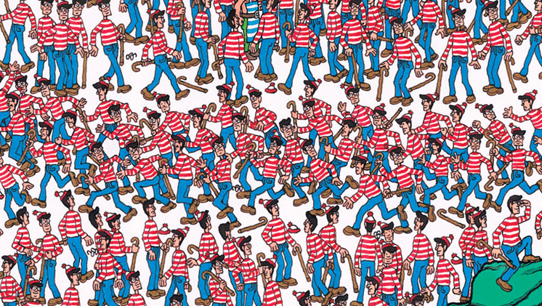
Where’s Jessica? Needfinding Take 2

Slide 7
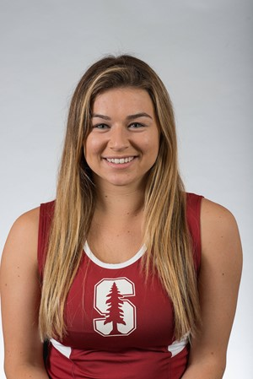
Paulette
Gluten Sensitivity
20 years old
Studies MS&E
Diagnosed last year
LOVES chocolate cake

Slide 8
SAY | THINK
DO | FEEL
“I feel a lot better and I know what’s going into my body”
Eating with my friends wouldn’t be so bad if they could just remember I am gluten free
I don’t want to be labeled as the “gluten free girl”
“it doesn’t take that great, I’m not gonna lie”
“sh*t there’s gluten in a lot of things”
“A lot of people who are “gluten free” aren’t actually gluten free”
“I had to take drugs when I slept to sedate me so I wouldn’t scratch myself”
“there’s been times where I’ve literally had to leave half the plate and I feel awful”
I wish there were more gluten free options
“I don’t want to be that person that’s like ‘oh I’m sorry I can’t eat this’”
It’s so difficult to figure out if something is gluten free, I’d rather just eat the few things I know are safe
“I don’t want to mess it up”
“I feel like a burden”
I feel so much better on my new diet, I can’t risk messing it up
“The food allergy testing isn’t that great, it’s not that conclusive”
“it definitely takes away from enjoying a meal because it adds a lot of stress”
even my friends sometimes can’t understand how hard it is to have and maintain my diet
“the office would always order food for us – I always had to order a salad w/ dressing on the side”
“I’m super lazy so I’ll just avoid it if I’m unsure about it because it’s just not worth it”
I wish I could put something on my salad other than olive oil
“especially when eating out sometimes I’m like I should just eat now so I don’t eat when I go out and inconvenience people”
“since it’s something that I’m not entirely sure about I don’t risk it
“you can have gluten free chocolate cake but its trash”
used air quotes every time she said “gluten-free”
showed off her arms (and lack of rashes)
Spoke assertively when talking about how healthy her diet is and quietly about the taste
uncomfortable to eat with others
unfairly judged
scared to change what’s working
unmotivated to understand her diet better
sat up straight when talking about strawberries and cream and then immediately slouched to describe the accompanying salad
cut us off mid-sentence to talk about her one wish that chocolate cake was gluten free
happy that the diet’s working
unsure of what she can eat
healthy physically
like a burden
frustrated by the gf stereotype
imitated people’s reaction to her not eating when at a restaurant or finding out she’s gluten-free
Laughed at her now choice salad dressing
nostalgic for real food
uneducated about her diet

Slide 9
SAY | THINK
DO | FEEL
It’s so difficult to figure out if something is gluten free, I’d rather just eat the few things I know are safe
I feel so much better on my new diet, I can’t risk messing it up
“I’m super lazy so I’ll just avoid it if I’m unsure about it because it’s just not worth it”
showed off her arms (and lack of rashes)
Spoke assertively when talking about how healthy her diet is and quietly about the taste
scared to change what’s working
cut us off mid-sentence to talk about her one wish that chocolate cake was gluten free
happy that the diet’s working
nostalgic for real food

Slide 10
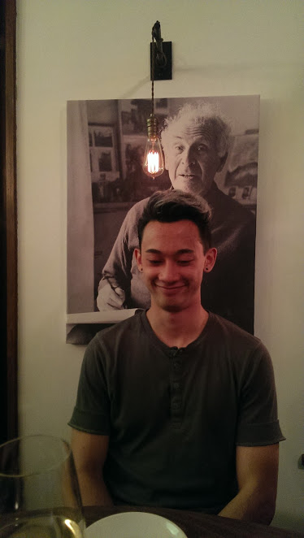
Dylan
Allergic to…Everything
21 years old
Student
Diagnosed late freshman year of college
Just wants a nice cold beer...and some Taco Bell

Slide 11
SAY | THINK
DO | FEEL
“I don’t know what else I’m allergic to”
“I can’t focus - that’s the worst part”
“if I can eat potatoes, that’s down the road, one day I might be able to eat french fries with my friends”
“mostly everyday it’s just white rice, chicken and a salad”
“Last time I had a gluten free burger in San Diego that I thought would be safe, but I still don’t know what it had that made me sick”
It’s better to avoid food that make me sick than to eat them and be unable to concentrate
“It’s hard to be social if you can’t get a meal with someone”
Sometimes I’m really starving and the dining hall is closed and I do something stupid like having sushi with wheat on it”
“some people can’t eat gluten, I can't eat this list of 7 or more things”
“I almost took this quarter off to figure my allergies out, but I want to f*** graduate”
I’ll occasionally have some foods I’m not supposed to because I can’t control myself all the time
“I wish I could eat chipotle, tacos, mexican food in san diego, and beer…. Yeah i wish I could drink some beer”
“In the past 3 to 4 months there wasn’t a moment when I got sick, I was pretty much sick the whole time, just different degrees”
I shouldn’t go out with friends if I can’t eat anything
“I don’t mind eating only chicken if it means I can read a book”
“I can’t really trust them anyway, they don’t know everything that is on the food inside out and the chefs are busy”
His intolerance will eventually fade away
My diet right now is so restricted that it’s pretty much a guaranteed I can’t eat somewhere.
used bathroom in the middle of the interview
kept eye contact during the interview
longing for something with flavor
optimistic that his restrictions aren’t permanent
isolated from his friends
frustrated with how his food affects his health
Didn’t let me buy him coffee because it would probably “react” to the ritalin he had just taken
resigned to his situation
bored with his diet
alone
Stopped the interview to play Pokemon
overwhelmed by how much he should know but doesn’t and sometimes can’t
powerless
took a sandwich out of his backpack and showed it

Slide 12
SAY | THINK
DO | FEEL
“if I can eat potatoes, that’s down the road, one day I might be able to eat french fries with my friends”
It’s better to avoid food that make me sick than to eat them and be unable to concentrate
“It’s hard to be social if you can’t get a meal with someone”
“I can’t really trust them anyway”
I shouldn’t go out with friends if I can’t eat anything
“My diet right now is so restricted that it’s pretty much a guaranteed I can’t eat somewhere.”
Didn’t let me buy him coffee because it would probably “react” to the ritalin he had just taken
isolated from his friends
alone
Stopped the interview to play Pokemon
took a sandwich out of his backpack and showed it

Slide 13

Jason
Milk Allergy – he’s not lactose intolerant
26 years old
Married
Works as a pipefitter
From Fremont
High School Graduate

Slide 14
SAY | THINK
DO | FEEL
“The symptoms to the allergy start showing up within a few minutes but may sometimes take longer”
“It’s easier to remember want I can eat, than to remember what I shouldn’t eat.”
My wife always has to cook separate dishes for both of us or cook something she might not like
“I have limited options when I go out. I have to tell the waiter multiple times, not to add butter or any dairy products to my food
“You don’t see a lot of adults like me who are allergic to milk”
My diet is so limited, that I feel frustrated eating a limited variety of items
“It sucks not being able to drink milk, eat cheese or cakes”
“I feel bad, for making them go the extra mile to make something specifically for me”
“People think it is the same thing as lactose intolerant”
I just wonder how much easier my life would have been, had I not had an allergy
“Even though I can’t eat whatever I want, at least I am healthy”
“I have to make do with alternatives”
laughed when asked about the things he couldn’t eat
felt embarrassed with his situation
frustrated with his allergy
wanted to eat pizza or cheese like everyone else
was sitting at the kitchen during the interview and sarcastically showed the cheese at his fridge
affected his day to day life
wasn’t excited about his limited food choices
just wanted a glass of milk
laughed whenever I said pizza
glad that he was seeing some improvements
was excited to talk about his cure options
felt happy that his family helped out

Slide 15
SAY | THINK
DO | FEEL
My wife always has to cook separate dishes for both of us or cook something she might not like
“I feel bad, for making them go the extra mile to make something specifically for me”
I just wonder how much easier my life would have been, had I not had an allergy
“I have to make do with alternatives”
laughed when asked about the things he couldn’t eat
frustrated with his allergy
wanted to eat pizza or cheese like everyone else
laughed whenever I said pizza
felt happy that his family helped out

Slide 16
REVISING OUR POV

Slide 17
WE MET Paulette
WE WERE AMAZED TO REALIZE how self-conscious she is about eating with other people because she feels like a burden
IT WOULD BE GAME-CHANGING IF her diet could benefit the people she eats with
WE MET Paulette
WE WERE AMAZED TO REALIZE how much she likes having structure in her life
IT WOULD BE GAME-CHANGING IF she could use her diet as another source of structure
WE MET Paulette
WE WERE AMAZED TO REALIZE the strain that she feels her diet puts on those around her
IT WOULD BE GAME-CHANGING IF she could use her diet as a way to strengthen her current relationships and build new ones
We met Jason
We were amazed to realize he felt miserable most of the time
It would be game changing if we could cheer him up or keep him distracted
WE MET Dylan and Jason
WE WERE AMAZED TO REALIZE that they can’t stay away for home long because they needs to be able to get a safe meal
IT WOULD BE GAME-CHANGING IF he could identify and obtain safe snacks and meals to get him through the day
WE MET Paulette
WE WERE AMAZED TO REALIZE how hard it is to be gluten free in a work place
IT WOULD BE GAME-CHANGING IF her restrictions could be used as a way to “spice up” work place meals
We met Jason
We were amazed to realize he can’t eat cakes
It would be game changing if we could suggest to him a recipe that doesn’t need milk
We met Jason
We were amazed to realize his diet restricts his ability to do his job
It would be game changing if we could find a workaround, such as working overtime when he falls ill
WE MET Paulette
WE WERE AMAZED TO REALIZE how much she dreads the invitation “lets get lunch”
IT WOULD BE GAME-CHANGING IF going out became an adventure to look forward too
WE MET Paulette
WE WERE AMAZED TO REALIZE how excited she got about chocolate cake
IT WOULD BE GAME-CHANGING IF she could have her cake and eat it too
WE MET Paulette
WE WERE AMAZED TO REALIZE how often people try to cook for her but forget she is gluten free
IT WOULD BE GAME-CHANGING IF there was a non-obvious way to indicate/remind about her restriction
We met Jason
We were amazed to realize he claimed to be allergic to a lot of foods, some of which might not be allergic
It would be game changing if we could easily find out which foods do not cause an allergic reaction
WE MET Dylan
WE WERE AMAZED TO REALIZE that he never eats out
IT WOULD BE GAME-CHANGING IF socializing for his friends didn’t mean going to a restaurant
WE MET Dylan
WE WERE AMAZED TO REALIZE how he views his diet as an obstacle to his social life
IT WOULD BE GAME-CHANGING IF his diet could become a way for him to make friends and socialize
We met Jason
We were amazed to realize that he eats home cooked food all the time
It would be game changing if he could shortlist a couple of places that are safe for him to eat
WE MET Dylan and Paulette
WE WERE AMAZED TO REALIZE how their symptoms materialized in college
IT WOULD BE GAME-CHANGING IF they could use their experiences to teach others about self-care
WE MET Paulette
WE WERE AMAZED TO REALIZE how scared she is to eat something that is probably safe but not pre-approved by her doctor
IT WOULD BE GAME-CHANGING IF she could expand her diet without fear
WE MET Dylan
WE WERE AMAZED TO REALIZE how he views his diet as an obstacle to his social life
IT WOULD BE GAME-CHANGING IF his diet could become a way for him to make friends and socialize
We met Jason
We were amazed to realize that his wife cooks a different meal for him and another for herself
It would be game changing if we could suggest different varieties of food that she would like but does not cause his allergy to flare up
WE MET Paulette
WE WERE AMAZED TO REALIZE how unmotivated she can be to learn more about what she can and can’t eat
IT WOULD BE GAME-CHANGING IF learning about her diet could be made into an activity or hobby
WE MET Jessica
WE WERE AMAZED TO REALIZE she hates eating out because of the difficulties of finding a place her daughter can eat
IT WOULD BE GAME-CHANGING IF she didn’t have to spend so much with the issue
WE MET Dylan
WE WERE AMAZED TO REALIZE how hard it is to travel with his diet
IT WOULD BE GAME-CHANGING IF his limitation could be used to add adventure to his travels
WE MET Dylan and Jason
WE WERE AMAZED TO REALIZE how hard it is to travel because of their eating restrictions
IT WOULD BE GAME-CHANGING IF they could have a list of safe places to eat wherever they went
WE MET Paulette
WE WERE AMAZED TO REALIZE how hard it can be to identify if something is REALLY gluten free
IT WOULD BE GAME-CHANGING IF she could just know w/ certainty what is and isn’t okay for her to eat
WE MET Ellie
WE WERE AMAZED TO REALIZE how much tension is caused due to her and her husband’s different diets
IT WOULD BE GAME-CHANGING IF eating could be used as a way to bring people together/strengthen relationships
WE MET Paulette
WE WERE AMAZED TO REALIZE how her roommate is willing to cook for her despite their different diets
IT WOULD BE GAME-CHANGING IF she could find a network of these same type of people
WE MET Dylan
WE WERE AMAZED TO REALIZE that he doesn’t know anyone else with his type of restrictions
IT WOULD BE GAME-CHANGING IF this diet could bring people with the same or similar conditions together
We met Jason
We were amazed to realize that his wife cooks a different meal for him and another for herself
It would be game changing if we could suggest different varieties of food that she would like but does not cause his allergy to flare up
WE MET Jessica
WE WERE AMAZED TO REALIZE how much she despises cooking
IT WOULD BE GAME-CHANGING IF cooking could be used a way to spend time with the people she loves(is doing the cooking for)

Slide 18
POV #1
Redefining Social Eating

Slide 19
We met Dylan and were AMAZED to learn
that he had an intense aversion to, and even feared, eating out or being invited to eat out

Slide 20
The GAME- CHANGER
What if we could redefine the traditional practice of socializing over a meal to be something enjoyable experience for both restricted and non-restricted eaters…

Slide 21
POV #2
Sharing is Caring

Slide 22
We met Jason and were AMAZED to learn
For EVERY meal, his wife will cook one thing for herself and another thing for Jason

Slide 23
The GAME- CHANGER
What if there was a way for people with different diets to share AND ENJOY the same meal …

Slide 24
POV #3
Less Thinking, More Eating, No Worries

Slide 25
We met Paulette and were AMAZED to learn
That she will settle for eating the same bland, boring food because there is too much effort and risk involved with expanding her diet

Slide 26
The GAME- CHANGER
What if people could just know the nutritional and chemical consequences of any food they were considering to eat…

Slide 27
HOW MIGHT WE…?

Slide 28
Redefine Social Eating 1) Give people more optionality when they go out to eat 2) Make eating out an adventure 3) Use people’s restrictions as a way to build relationships 4) Make eating an organized activity 5) Make the experience about cooking rather than eating 6) Use eating restrictions as a way to find people like oneself 7) Incorporate the travel to and from the restaurant into the eating experience 8) Change eating out from a passive to an active activity 9) Separate socializing and eating as mutually exclusive activities 10) Make eating in more enticing than eating out
Shared Meal
1) Recommend ingredient safe alternatives but retain the intended flavors
2) Share the experience of meal planning rather than that of eating
3) Create meals that are safe but also customizable
4) Find other people to share meals with
5) Use meal sharing as a way to teach others about your diet
6) Make preparing a shareable meal simple and easy
7) Incentivize people to compromise on a meal
8) Reward creativity in the kitchen that leads to compatible recipes
9) Punish meal segregation
10) Turn exploring others diets a hobby
How to Know
1) Make being accountable for knowing the facts meaningful
2) Provide on-the-spot food facts
3) Eliminate the need to know facts
4) Incentivize learning about one’s diet
5) Reward awareness and “punish” ignorance
6) Make diet maintenance about having “knowledge” and not “knowing” facts
7) Make a game out of learning about one’s diet
8) Make learning about one’s diet a shared experience
9) Create a better way to remind people about the consequences of not knowing the facts
10) Make it easier to read and understand nutrition labels/food speak

Slide 29
Redefine Social Eating Make eating out an adventure?
Shared Meal
Make sharing effortless?
How to Know
Make knowledge and accountability meaningful?

Slide 30
HOW MIGHT WE…SOLVE THESE?
Solutions and Prototype

Slide 31
Make Eating Out an Adventure? 1) Tasting tour of restriction friendly restaurants 2) Game-ified food-hunt 3) Potluck style cooking circle of people with like restrictions 4) Blind eating w/in limits of one’s restrictions 5) Eat at friend’s houses rather than restaurants 6) Order delivery from different places in groups and then do a food exchange 7) Swap favorited restaurants lists of people w/ like diets 8) Make getting to the restaurant the adventure 9) Have a restaurant subscription for diet friendly restaurants 10) Provide a restaurant of the week w/ order recommendations and rewards for eating there
Make Sharing Easy?
1) “Uber” chefs
2) Yelp-like restaurant recommender trusted forum for the diet restricted
3) Food thesaurus
4) Cooking rotation w/ a variety of like dieters
5) On-demand nutritionist/food consultant
6) Recipe/meal recommender system
7) Group meal delivery
8) Provide a “meal of the day” for each type of restricted diet
9) Diet sharing – those who do have appropriate recipes share their ideas of verified meals w/ those who don’t
10) Mentor-mentee buddy system where the people can take and give advice
Meaningful Accountability and Knowledge?
1) Find peers to set and achieve diet needs and goals
2) Recipe swap and advice forum
3) Make the act of meal planning of hobby/club activity
4) Provide a household meal planning platform
5) Turn the planning experience into a game w/ a points system
6) Rewards system which gives points to joint effort/shared outcome meals
7) Binding contracts to help plan and stay w/in diet
8) Platform to publicize plans via blog, vlog, or individual posts
9) Host/attend instructional cooking series
10) Provide diet specific tip and fact of the day

Slide 32
Make Eating Out an Adventure? Tasting tour of restriction friendly restaurants
Make Sharing Easy?
On-demand chefs
Meaningful Knowledge and Accountability?
Find peers to set and achieve diet needs and goals

Slide 33
THE PROTOTYPES

Slide 34

Tasting Tour

Slide 35
Assumptions
Sampling different dishes from different restaurants is a satisfactory or better substitute for the traditional eating out experience
Primary target is the diet restricted tourist
Users will have confidence that the selected dishes and restaurants are safe

Slide 36

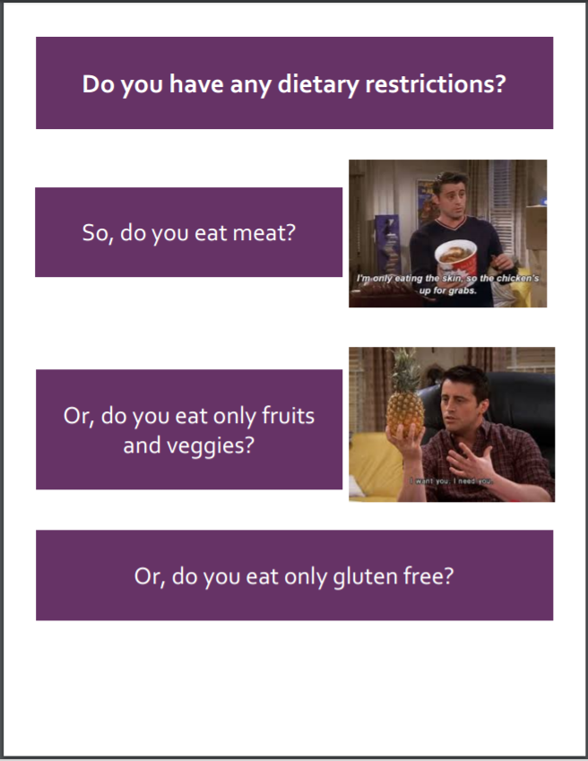
Construction

Slide 37
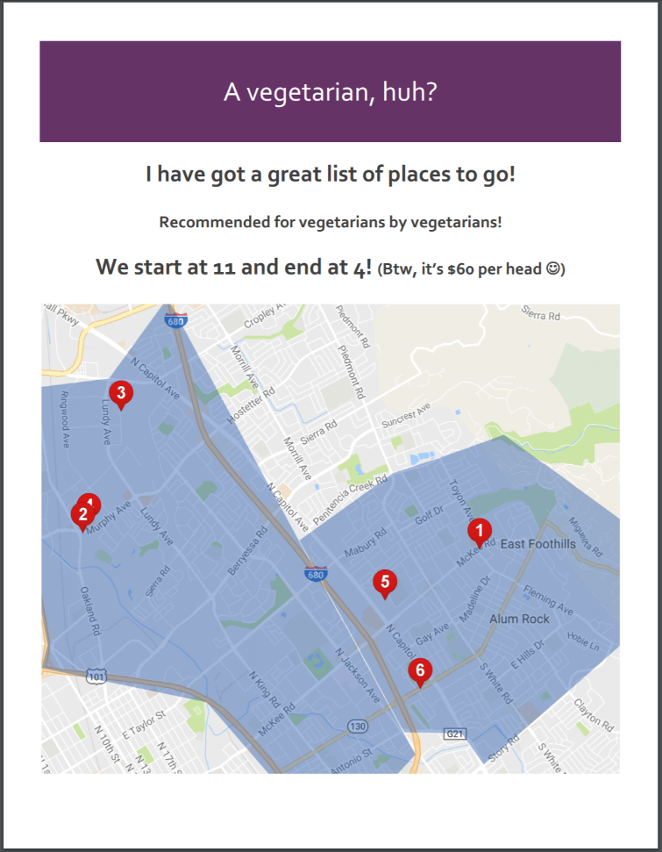
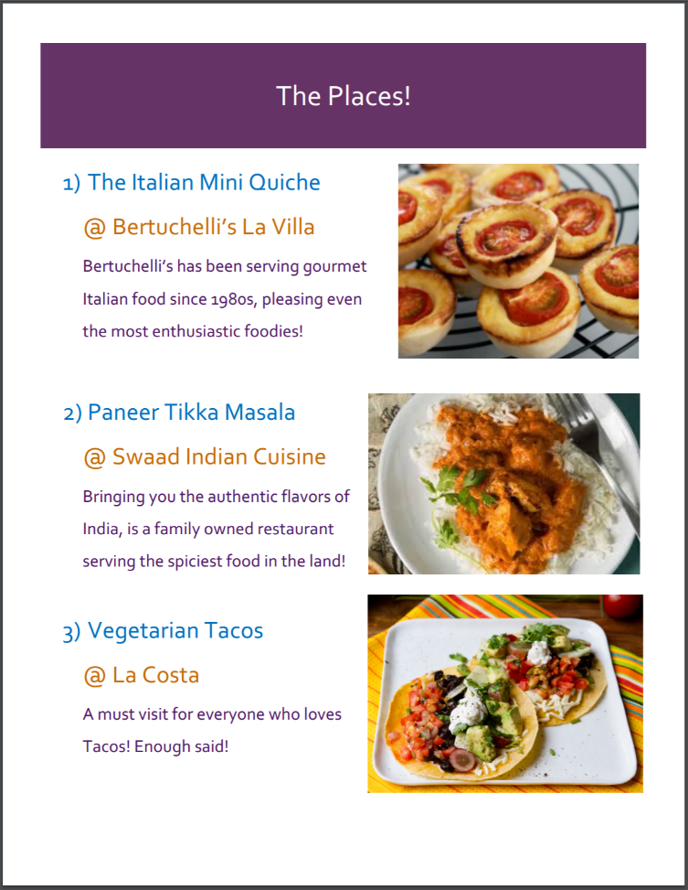
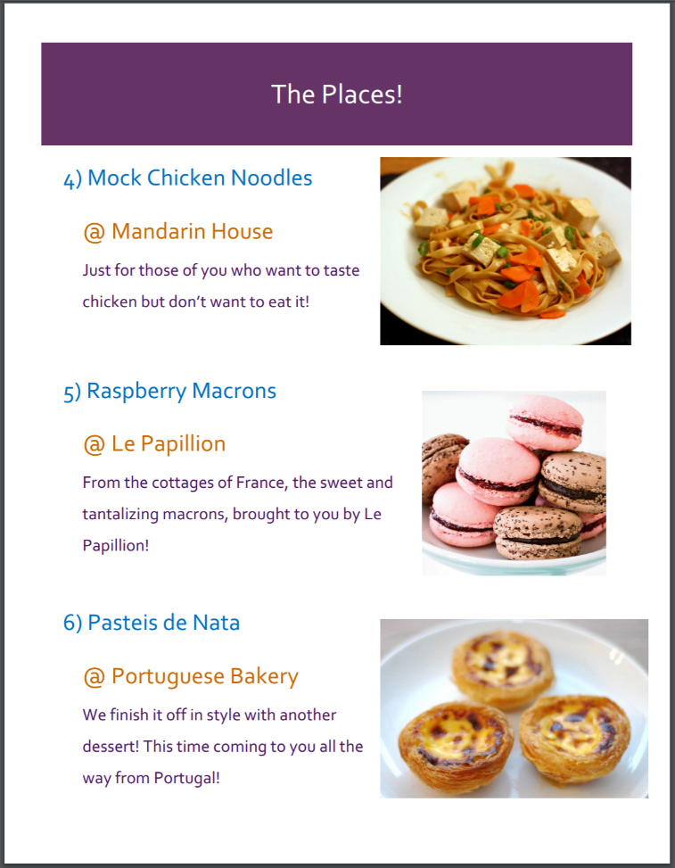
Construction

Slide 38
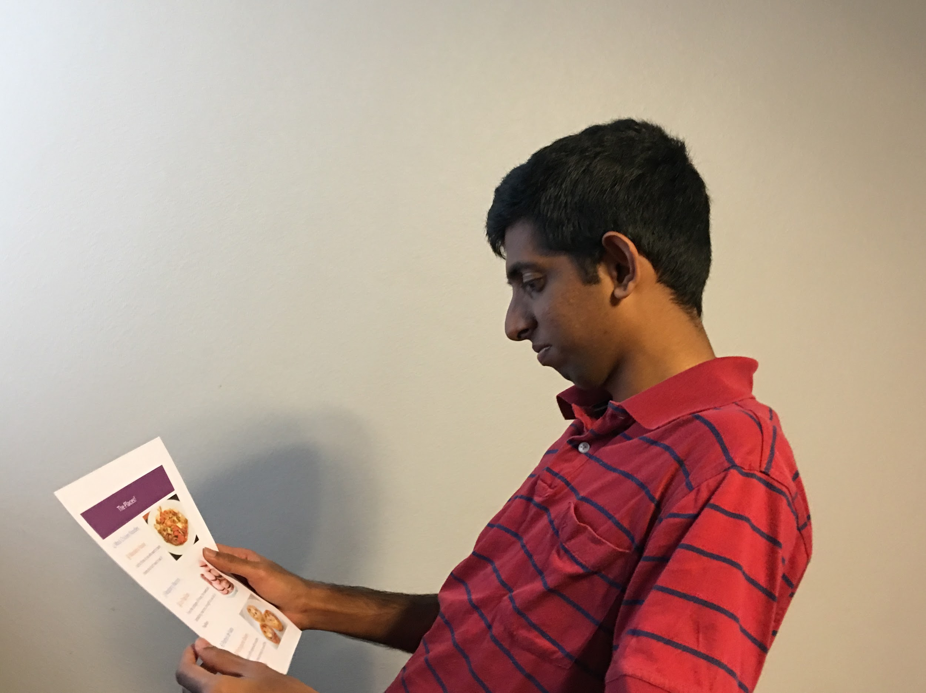
Testing
User: Thomas
Restriction: VEGETARIAN
Tour Guide: Senthil
Notes:
Thomas, 23, GeorgiaTech alumni, Lives in Sunnyvale, Works at VMWare

Slide 39
Results
Things that worked:
Things that didn’t:
Take-aways
Culture Aspect
Variety of Stops
Limited Choice
Price
Food Quantity and Consistency
Customization
Verification
Diversification

Slide 40


Validity
Substitutability:
Target User:
Trust:

Slide 41

On-demandChefs

Slide 42
Assumptions
The ordering a chef to cook for you removes the burden associated the thinking, planning, and effort of the meal prep process
The convenience of having someone else cook for you will make people okay with allowing a stranger into their kitchen
People would use an on-call chef for day-to-day meals

Slide 43
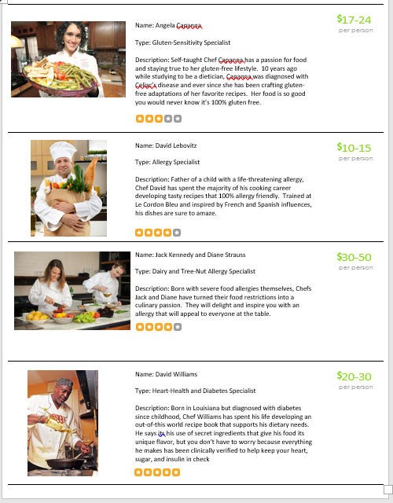
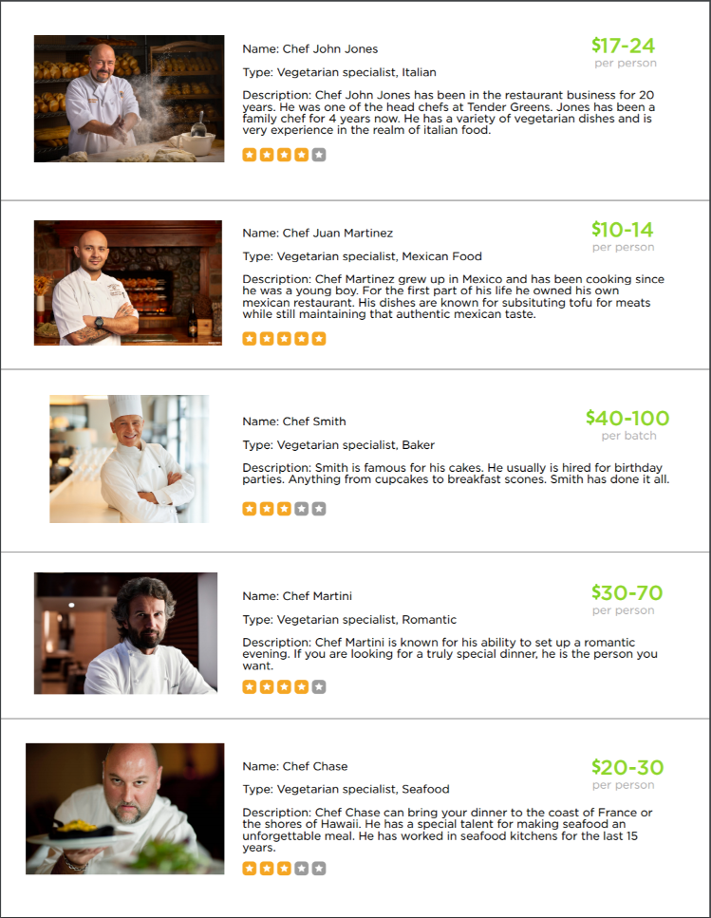
Construction

Slide 44
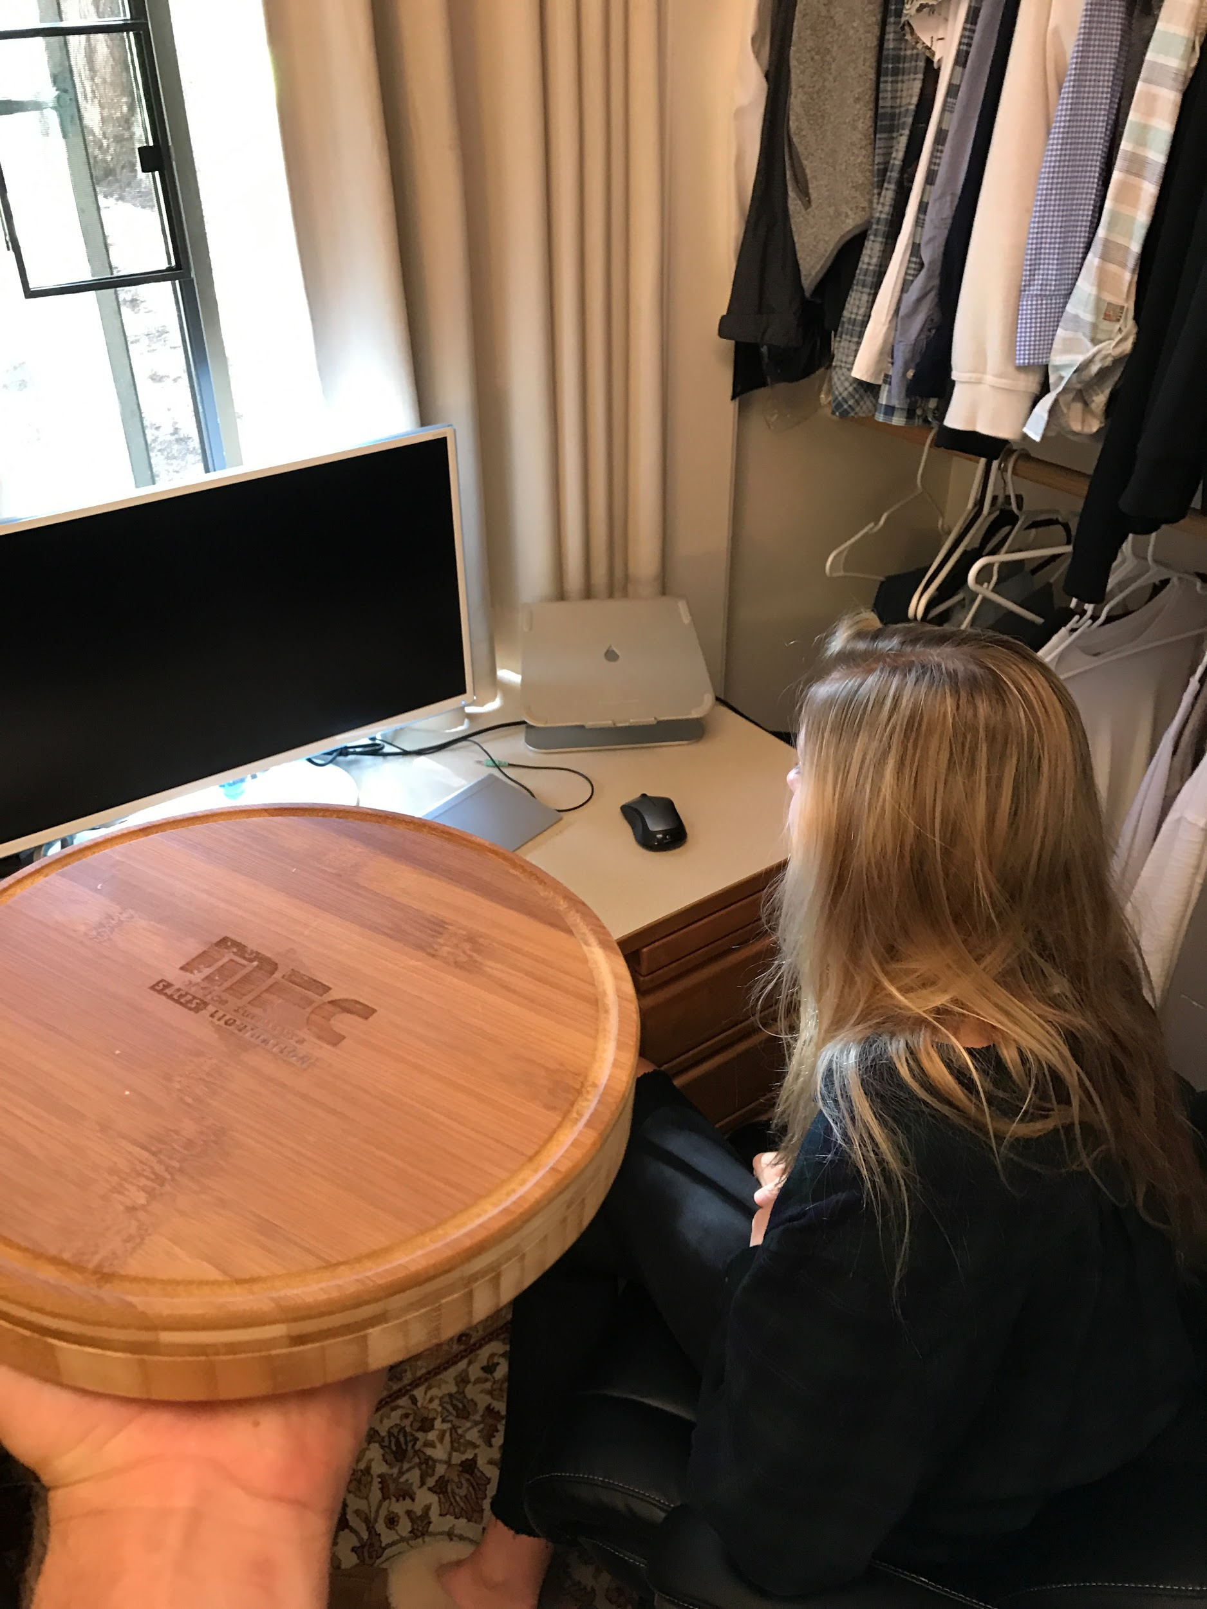
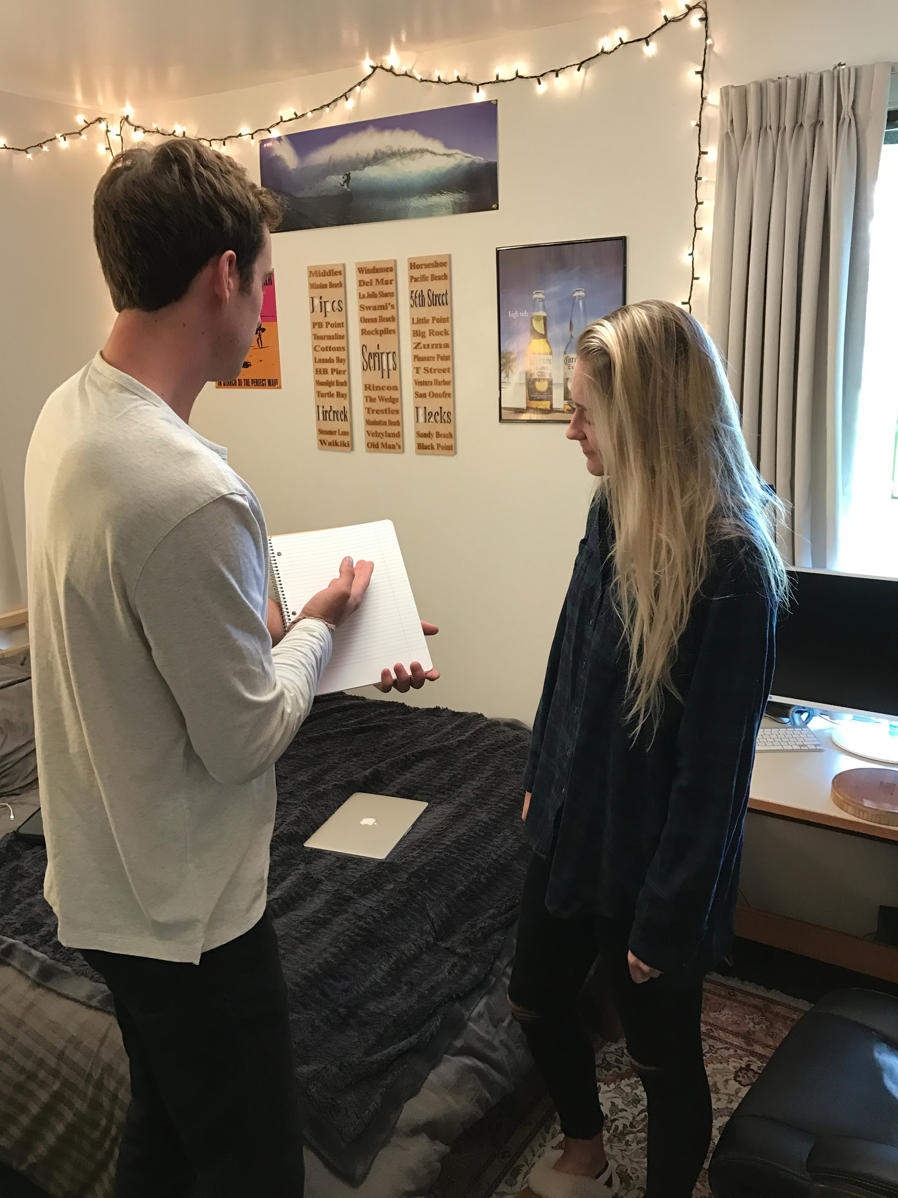
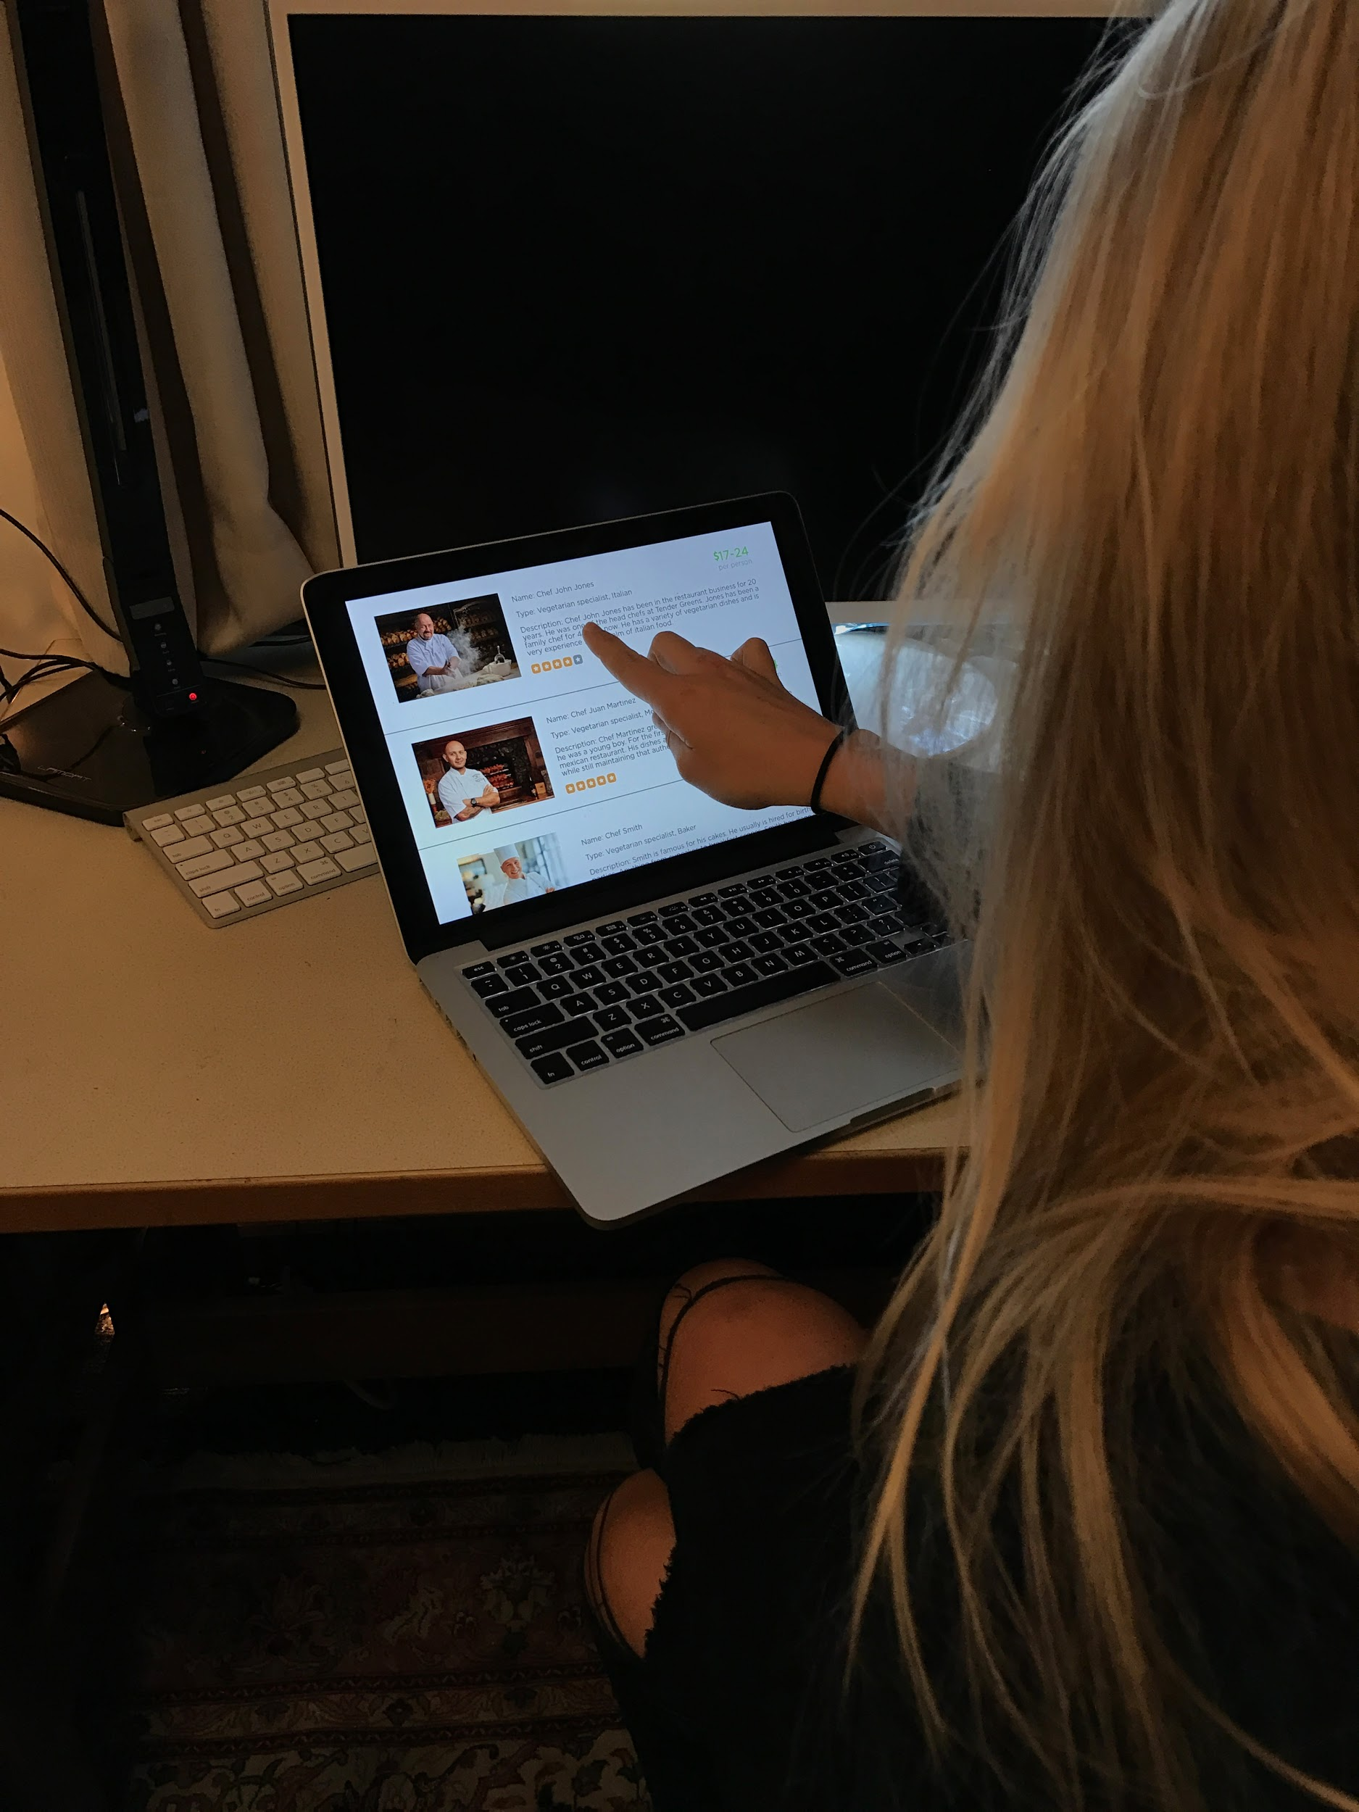
Testing
User: Kelsey
Restriction: VEGETARIAN

Slide 45
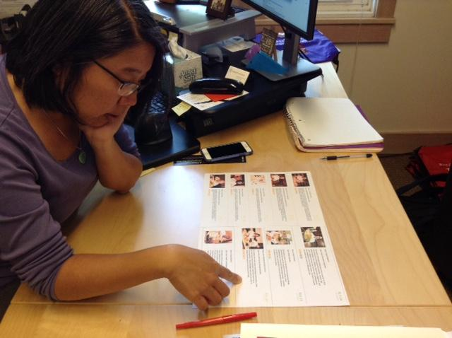
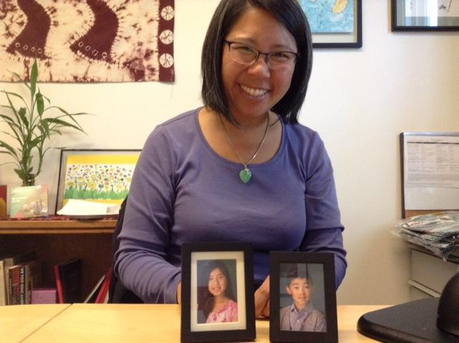
Testing
User: Jo
Restriction: mother of 2 HYPER-ALLERGIC children

Slide 46
Results
Things that worked:
Things that didn’t:
Take-aways
Presentation
User Chef Interaction
Star Ratings
Lacked Information
Optionality and Searchability
Privacy
Price and Rating Sensitivity
Framing Matters
Target User Matters
Verification

Slide 47
Validity
Less Burdensome:
Privacy:
Type of Use:

Slide 48
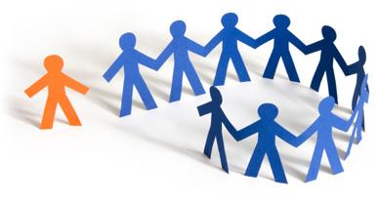
Group “Dieting”

Slide 49
Assumptions
Restricted eaters want to find others like them to help them stay motivated and set goals for their diet
Setting and achieving goals and diets is easier and more fun with a group
Restricted eaters want a better way to set and achieve their diet needs and/or goals

Slide 50
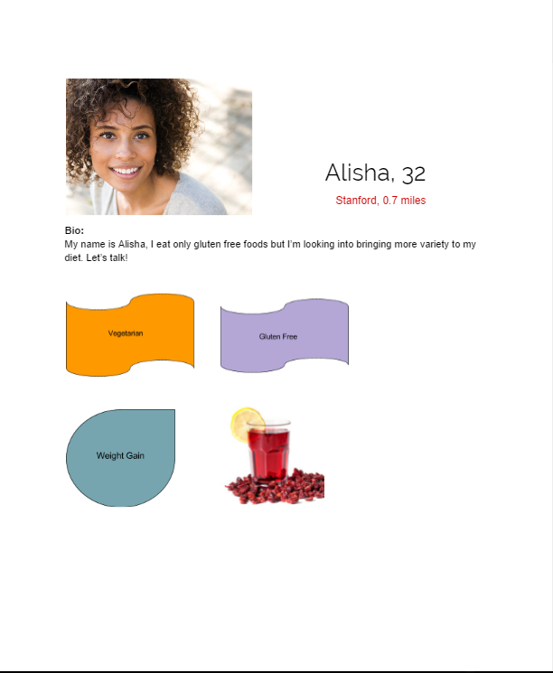
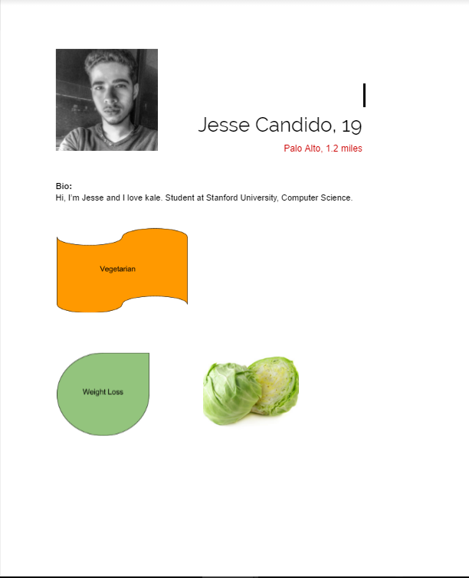
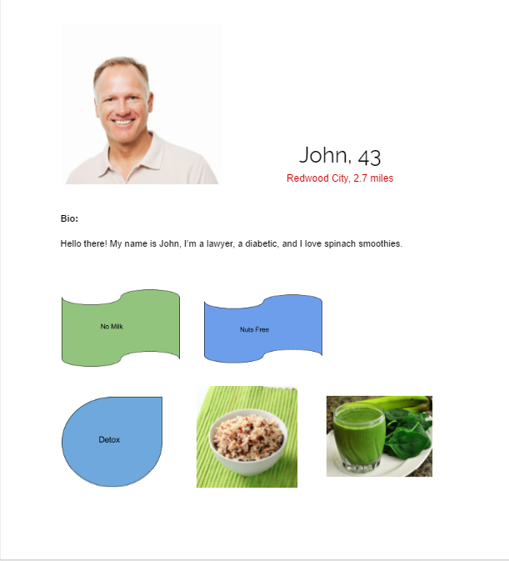
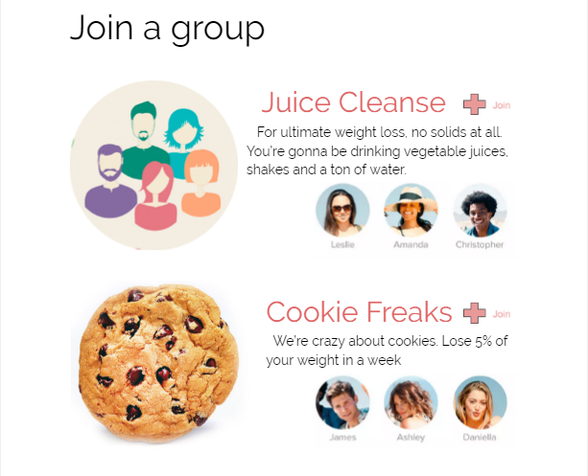
Construction

Slide 51
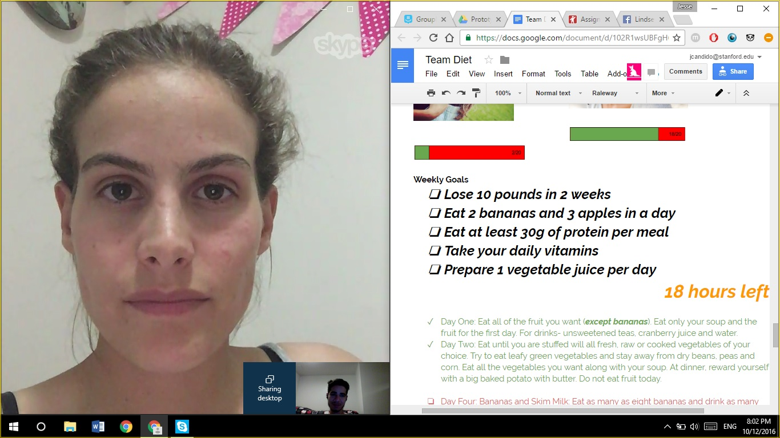
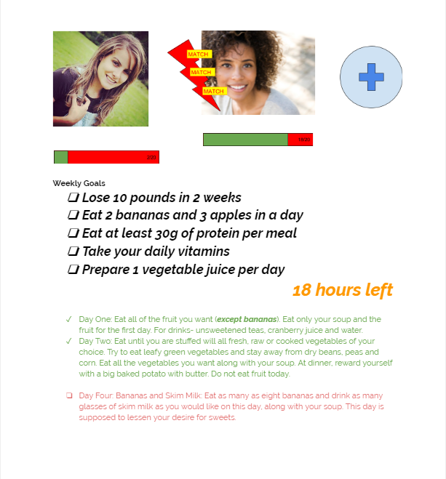
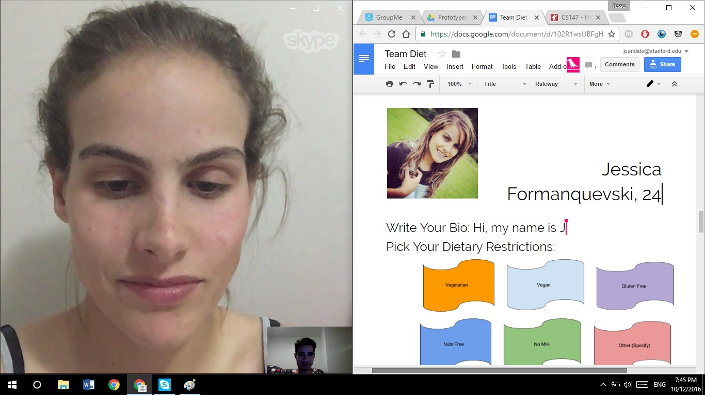
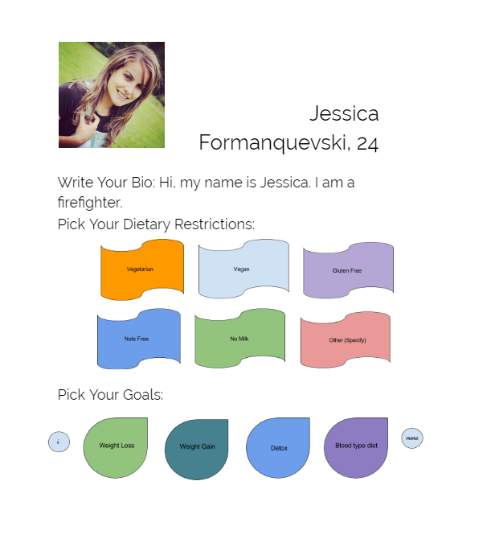
Testing
User: Jessica
Restriction: VEGETARIAN, MILK ALLERGY

Slide 52
Results
Things that worked:
Things that didn’t:
Take-aways
Easy and Intuitive
Communication
Goals Setting
Time Commitment
Diet Selection
Between User Interaction
More Guidance
Frequency and Type of Use

Slide 53
Validity
Meet and Diet w/ Peers:
Fun and Easy:
Importance of Goal Setting:

Slide 54
Take-aways and New Assumptions

Slide 55
People really care about interacting with people who have shared restrictions and experiences
People don’t like constraints
TRUST
Our focus still was not narrow enough

Slide 56
Thank You

Slide 57
Index

Slide 58
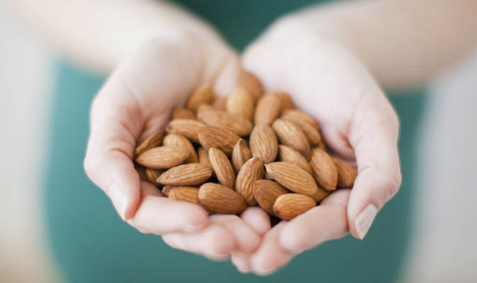
New POV

Slide 59
Madison
Vegetarian
Professional volleyball player in Sweden
Stanford Graduate
23
From Los Angeles, California

Slide 60
SAY | THINK
DO | FEEL
“It is sometimes hard to get enough calories at team meals because they eat a lot of meat before and after workouts”
He is tired of the inconvenience when it comes to team meals
He sometimes just resorts to the same foods that he is tired of in order to fill his eating requirements.
“I usually resort to pasta and salads”
“It can also be socially awkward to tell waiters and such that I cannot eat their food because of the language barrier.”
As a professional athlete, it can be sometimes hard to get enough protein after my workouts”
He is thinking that his diet may have effects on his career and his social life in Sweden.
He feels frustrated by not being able to eat efficiently enough while in Sweden.
Raised his voice in frustration when talking about team meals.
Didn’t seem to have a confident answer to questions that asked how he plans to make his diet live up to his professional career.
His home and Stanford catered well to his diet needs, but now he does not have as much of a support system for his diet.
He is scared that his diet could have a major impact on his career because it is so heavily based on health and performance.
Acted nostalgic and reminiscent when talking about his mom’s cooking at home

